Slide 1
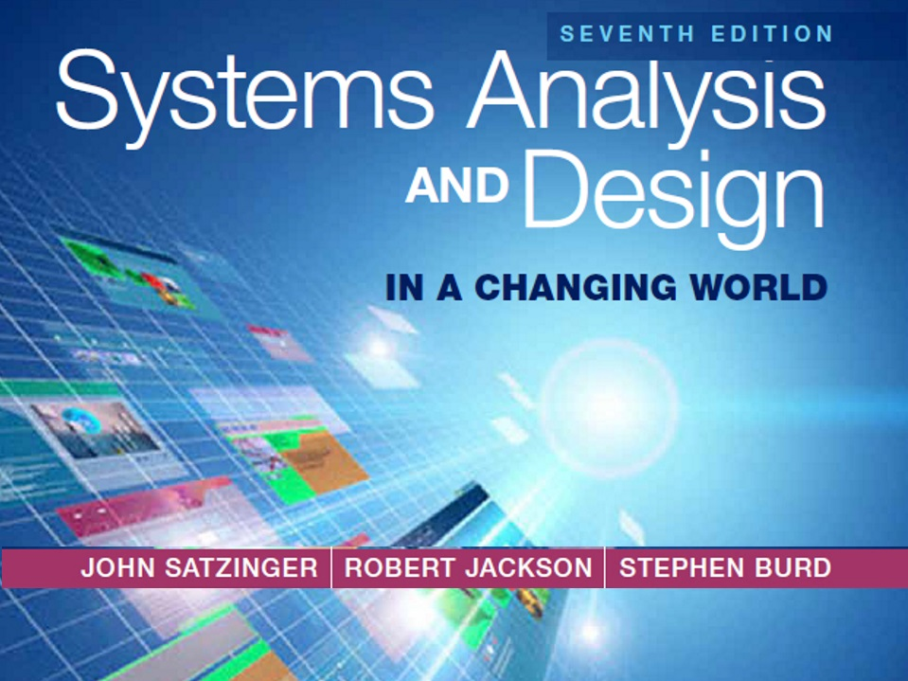
Chapter 4

Slide 2
Domain Modeling
Chapter 4
Systems Analysis and Design in a Changing World 7th Ed
Satzinger, Jackson & Burd

Slide 3
Chapter 4 Outline
“Things” in the Problem Domain
The Entity-Relationship Diagram
The Domain Model Class Diagram
The State Machine Diagram – Identifying Object Behavior

Slide 4
Learning Objectives
Explain how the concept of “things” in the problem domain also define requirements
Identify and analyze data entities and domain classes needed in the system
Read, interpret, and create an entity-relationship diagram
Read, interpret, and create a domain model class diagram
Understand the domain model class diagram for the RMO Consolidated Sales and Marketing System
Read, interpret, and create a state machine diagram that models object behavior

Slide 5
Overview
This chapter focuses on another key concept for defining requirements— data entities or domain classes
In the RMO Tradeshow System from Chapter 1, some domain classes are Supplier, Product, and Contact
In this chapter’s opening case Waiters on Call, examples of domain classes are Restaurants, Menu Items, Customers, Orders, Drivers, Routes, and Payments

Slide 6
Things in the Problem Domain
Problem domain—the specific area (or domain) of the users’ business need that is within the scope of the new system.
“Things” are those items users work with when accomplishing tasks that need to be remembered
Examples of “Things” are products, sales, shippers, customers, invoices, payments, etc.
These “Things” are modeled as domain classes or data entities
In this course, we will call them domain classes. In database class you may call them data entities

Slide 7
Things in the Problem Domain Two Techniques for Identifying Them
Brainstorming Technique
Use a checklist of all of the usual types of things typically found and brainstorm to identify domain classes of each type
Noun Technique
Identify all of the nouns that come up when the system is described and determine if each is a domain class, an attribute, or not something we need to remember

Slide 8
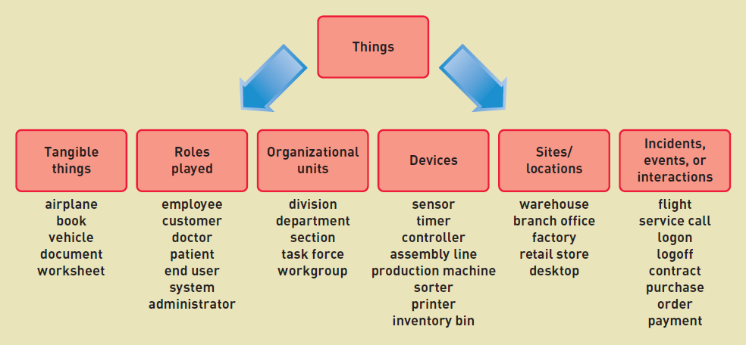
Brainstorming Technique
Are there any tangible things? Are there any organizational units? Sites/locations? Are there incidents or events that need to be recorded?

Slide 9
Brainstorming Technique: Steps
Identify a user and a set of use cases
Brainstorm with the user to identify things involved when carrying out the use case—that is, things about which information should be captured by the system.
Use the types of things (categories) to systematically ask questions about potential things, such as the following: Are there any tangible things you store information about? Are there any locations involved? Are there roles played by people that you need to remember?
Continue to work with all types of users and stakeholders to expand the brainstorming list
Merge the results, eliminate any duplicates, and compile an initial list

Slide 10
The Noun Technique
A technique to identify problem domain classes (things) by finding, classifying, and refining a list of nouns that come up in in discussions or documents
Popular technique. Systematic.
Does end up with long lists and many nouns that are not things that need to be stored by the system
Difficulty identifying synonyms and things that are really attributes
Good place to start when there are no users available to help brainstorm

Slide 11
The Noun Technique: Steps
Using the use cases, actors, and other information about the system— including inputs and outputs—identify all nouns.
For the RMO CSMS, the nouns might include customer, product item, sale, confirmation, transaction, shipping, bank, change request, summary report, management, transaction report, accounting, back order, back order notification, return, return confirmation…
Using other information from existing systems, current procedures, and current reports or forms, add items or categories of information needed.
For the RMO CSMS, these might include price, size, color, style, season, inventory quantity, payment method, and shipping address.

Slide 12
The Noun Technique: Steps (continued)
As this list of nouns builds, refine it. Ask these questions about each noun to help you decide whether you should include it:
Is it a unique thing the system needs to know about?
Is it inside the scope of the system I am working on?
Does the system need to remember more than one of these items?
Ask these questions to decide to exclude it:
Is it really a synonym for some other thing I have identified?
Is it really just an output of the system produced from other information I have identified?
Is it really just an input that results in recording some other information I have identified?
Ask these questions to research it:
Is it likely to be a specific piece of information (attribute) about some other thing I have identified?
Is it something I might need if assumptions change?

Slide 13
The Noun Technique: Steps (continued)
Create a master list of all nouns identified and then note whether each one should be included, excluded, or researched further.
Review the list with users, stakeholders, and team members and then define the list of things in the problem domain.

Slide 14
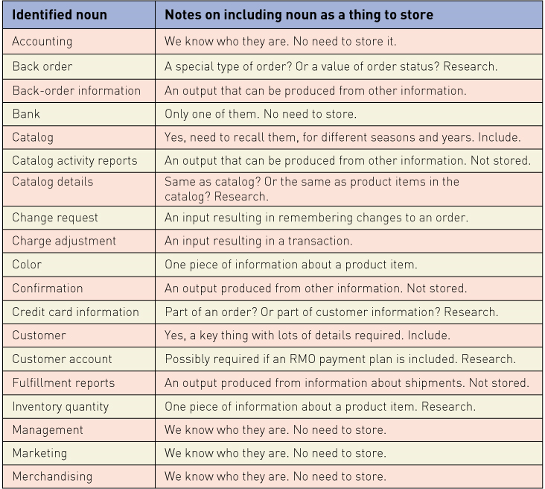
Partial List of Nouns for RMO
With notes on whether to include as domain class

Slide 15
Details about Domain Classes
Attribute— describes one piece of information about each instance of the class
Customer has first name, last name, phone number
Identifier or key
One attribute uniquely identifies an instance of the class. Required for data entities, optional for domain classes. Customer ID identifies a customer
Compound attribute
Two or more attributes combined into one structure to simplify the model. (E.g., address rather than including number, street, city, state, zip separately). Sometimes an identifier or key is a compound attribute.

Slide 16
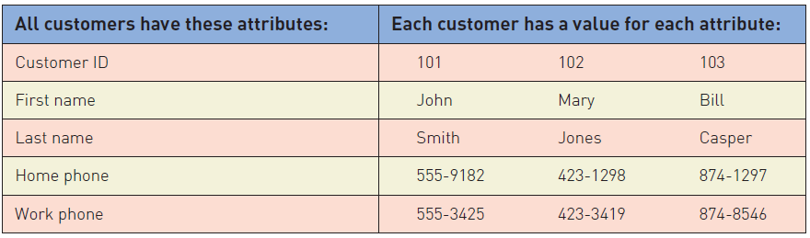
Attributes and Values
Class is a type of thing. Object is a specific instance of the class. Each instance has its own values for an attribute

Slide 17
Associations Among Things
Association— a naturally occurring relationship between classes (UML term)

Slide 18
Just to Clarify…
Called association on class diagram in UML
Multiplicity is term for the number of associations between classes: 1 to 1 or 1 to many (synonym to cardinality)
UML is the primary emphasis of this text
Called relationship on ERD in database class
Cardinality is term for number of relationships in entity relationship diagrams: 1 to 1 or 1 to many (synonym to multiplicity)
Associations and Relationships apply in two directions
Read them separately each way
A customer places an order
An order is placed by a customer

Slide 19
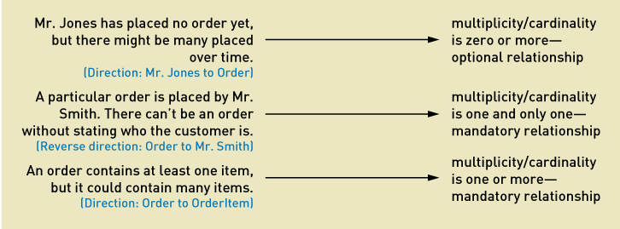
Minimum and Maximum Multiplicity
Associations have minimum and maximum constraints
minimum is zero, the association is optional
If minimum is at least one, the association is mandatory

Slide 20
Types of Associations
Binary Association
Associations between exactly two different classes
Course Section includes Students
Members join Club
Unary Association (recursive)
Associations between two instances of the same class
Person married to person
Part is made using parts
Ternary Association (three)
N-ary Association (between n)

Slide 21
Entity-Relationship Diagrams ERD
ERDs have been used for many years to develop data models that are used in database development
The term for “things” in ERD models is data entities
ERD models are not UML models and do not use standard UML notation
ERD models are not as expressive as UML models
They do not model generalization/specialization well
They do not model whole/part well

Slide 22
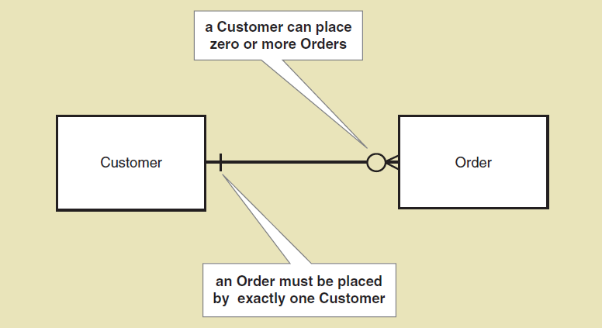
Example of ERD Notation
ERD Models normally use “crows feet” notation to show cardinality

Slide 23
ERD Cardinality Symbols
Examples of crows feet notation for various cardinalities

Slide 24
Expanded ERD with Attributes
ERD with cardinalities and attributes
There are several different notation methods for attributes in ERD models
This notation places attributes within data entities

Slide 25
Semantic Net
A semantic net is a graphical representation of an individual data entity and its relationship with other individual entities
It is often used to help understand and then develop an ERD model

Slide 26
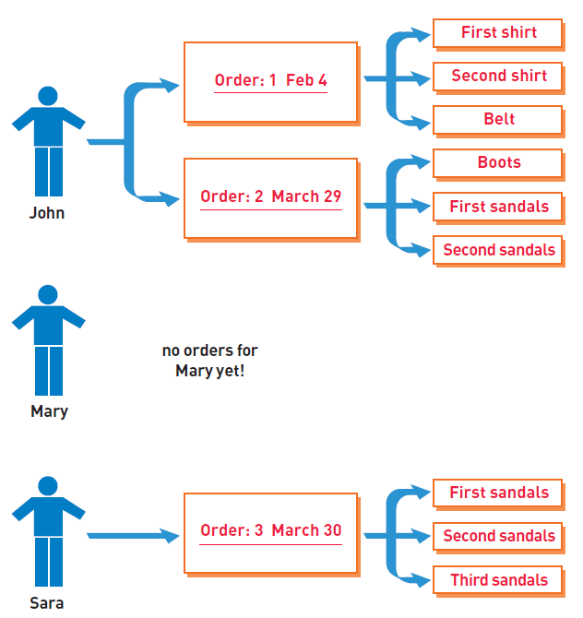
Semantic Net
This example shows three classes.
Quick quiz
What are the classes?
How many relationships?
What are min and max cardinalities?
What type of relationships are they?

Slide 27
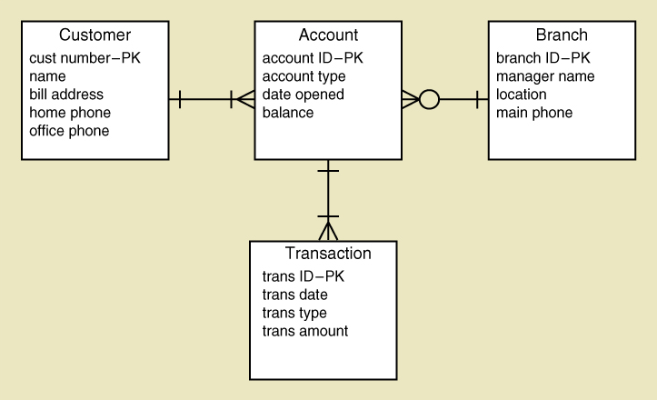
An ERD for a Bank
Quick Quiz
What are the key fields?
How many accounts can a customer have?
How many branches can a customer be assigned to?
How many customers can a branch have?

Slide 28
The Domain Model Class Diagram
Class
A type of classification used to describe a collection of objects
Domain Class
Classes that describe objects in the problem domain
Class Diagram
A UML diagram that shows classes with attributes and associations (plus methods if it models software classes)
Domain Model Class Diagram
A class diagram that only includes classes from the problem domain, not software classes so no methods

Slide 29
UML Domain Class Notation
Domain class a name and attributes (no methods)
Class name is always capitalized
Attribute names are not capitalized and use camelback notation (words run together and second word is capitalized)
Compound class names also use camelback notation

Slide 30
A Simple Domain Model Class Diagram
Note: This diagram matches the semantic net shown previously
A customer places zero or more orders
An order is placed by exactly one customer
An order consists of one or more order items
An order item is part of exactly one order

Slide 31
UML Notation for Multiplicity

Slide 32
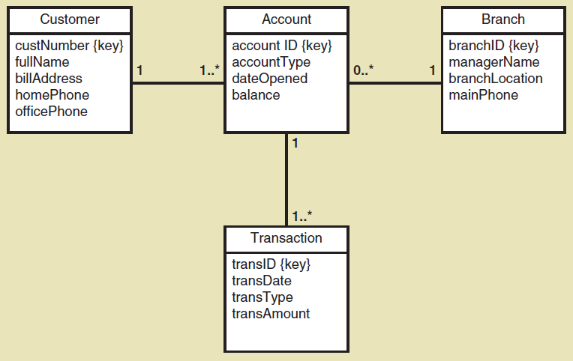
Domain Model Class Diagram
Bank with many branches as show previously in ERD
Note notation for the key
Note the precise notation for the attributes (camelback)
Note the multiplicity notation

Slide 33
Domain Model Class Diagram
Course Enrollment at a University
A Course has many CourseSections
A CourseSection has many Students and a Student is registered in many CourseSections
Problem
How/where to capture student grades?

Slide 34
Refined Course Enrollment Model with an Association Class CourseEnrollment
Association class— an association that is treated as a class in a many to many association because it has attributes that need to be remembered (such as grade)

Slide 35
Association Class Properties
The association class is the same “thing” as the association itself
The unique identifier (key) for the association class is the concatenation of the keys of the attached classes
In the previous example the key for CourseSection is CourseNumber+SectionNumber
Hence the key for CourseEnrollment is CourseNumber+SectionNumber+StudentID
Note: If more information is required to uniquely identify instances of the association class, then the model is incorrect, i.e., if the key cannot be formed by the concatenation of the endpoint keys, it is in error.

Slide 36
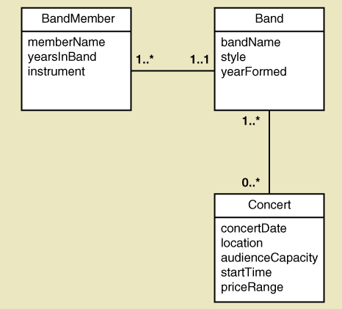
Band with members and concerts
Quick Quiz
How many bands can a person play in?
For a band, how many concerts can it play in?
For a concert, how many bands may be playing?
What attributes can you use for keys? Do you need to add “key” attributes?

Slide 37
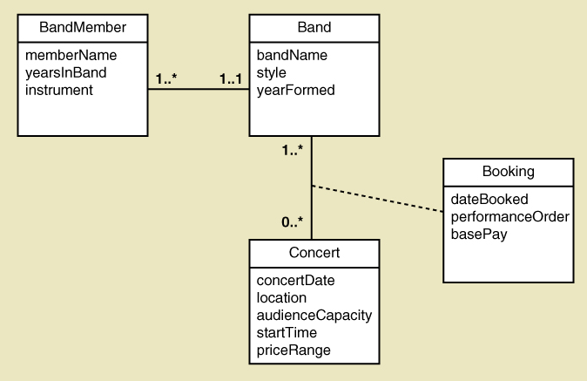
Band with Concert Booking Information
Note: The association class (Booking) also provides a name and meaning for the association
Given the keys you identified, what is the key for the Booking class? Does it uniquely identify instances?

Slide 38
More Complex Issues about Classes: Generalization/Specialization Relationships
Generalization/Specialization
A hierarchical relationship where subordinate classes are special types of the superior classes. Often called an Inheritance Hierarchy
Superclass
the superior or more general class in a generalization/specialization hierarchy
Subclass
the subordinate or more specialized class in a generalization/specialization hierarchy
Inheritance
the concept that subclasses classes inherit characteristics of the more general superclass

Slide 39
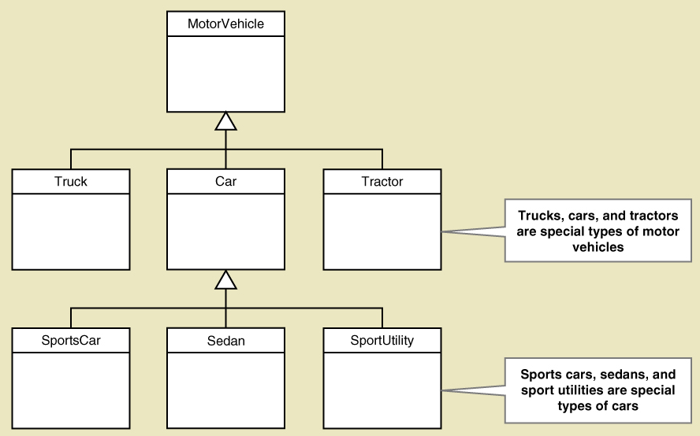
Generalization/Specialization

Slide 40
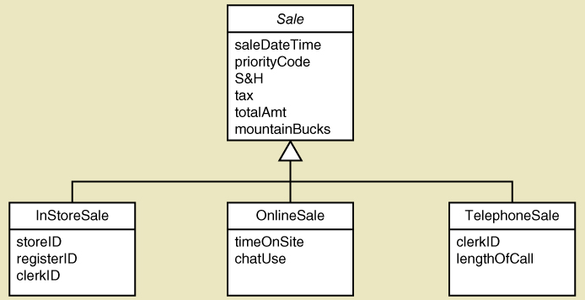
Generalization/Specialization Inheritance for RMO Three Types of Sales
Abstract class— a class that allow subclasses to inherit characteristics but never gets instantiated. In Italics (Sale)
Concrete class— a class that can have instances
Inheritance – Attributes of OnlineSale are:
timeOnSite, chatUse, saleDateTime, priorityCode, S&H, tax, totalAmt…

Slide 41
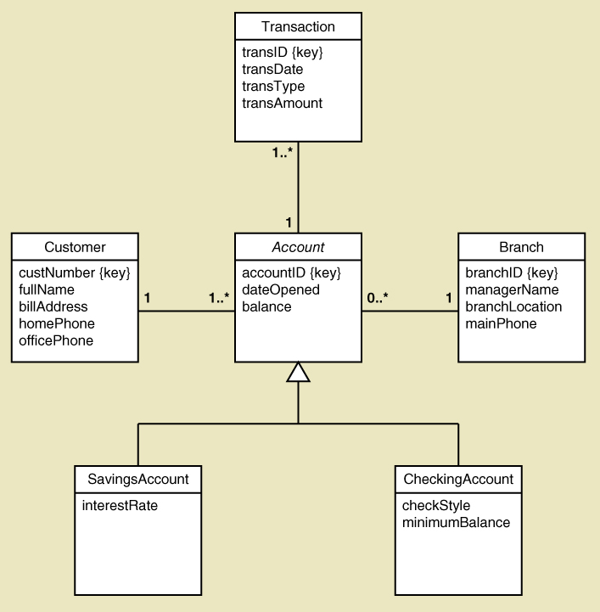
Generalization/Specialization Inheritance for the Bank with Special Types of Accounts
A SavingsAccount has 4 attributes
A CheckingAccount has 5 attributes
Note: the subclasses inherit the associations too

Slide 42
More Complex Issues about Classes: Whole Part Relationships
Whole-part relationship— a relationship between classes where one class is part of or a component portion of another class
Aggregation— a whole part relationship where the component part exists separately and can be removed and replaced (UML diamond symbol on next slide)
Computer has disk storage devices (storage devices exist apart from computer)
Car has wheels (wheels can be removed and still be wheels)
Composition— a whole part relationship where the parts cannot be removed (filled in diamond symbol)
OrderItem on an Order (without the Order, there are no OrderIterms)
Chip has circuits (without the chip, there are no circuits)

Slide 43
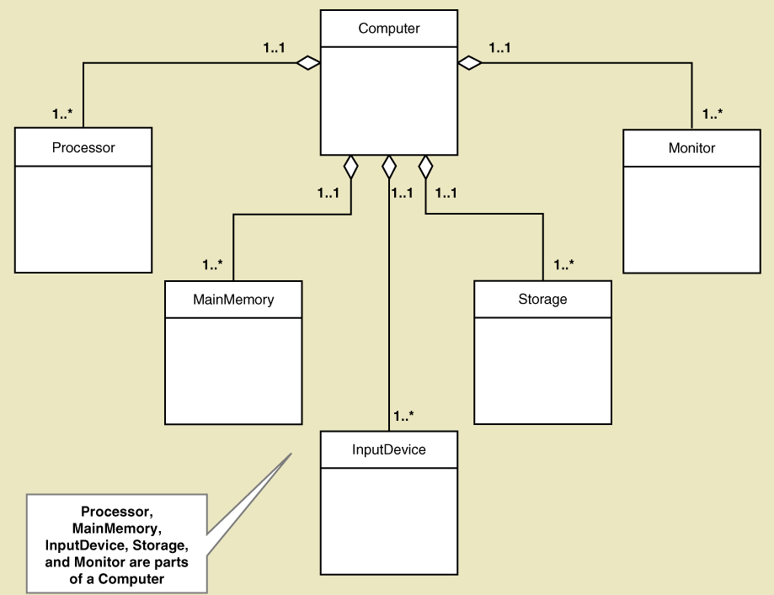
Whole Part Relationships Computer and its Parts
Note: this is composition, with diamond symbol.
Whole part can have multiplicity symbols, too (not shown)

Slide 44
More on UML Relationships
There are actually three types of relationships in class diagrams
Association Relationships
These are associations discussed previously, just like ERD relationships
Whole Part Relationships
One class is a component or part of another class
Generalizations/Specialization Relationships
Inheritance
Try not to confuse relationship with association

Slide 45
RMO CSMS Project Domain Model Class Diagrams
There are several ways to create the domain model class diagram for a project
RMO CSMS has 27 domain classes overall
Can create one domain model class diagram per subsystem for those working on a subsystem
Can create one overall domain model class diagram to provide an overview of the whole system
Usually in early iterations, an initial draft of the domain model class diagram is completed and kept up to date. It is used to guide development.

Slide 46
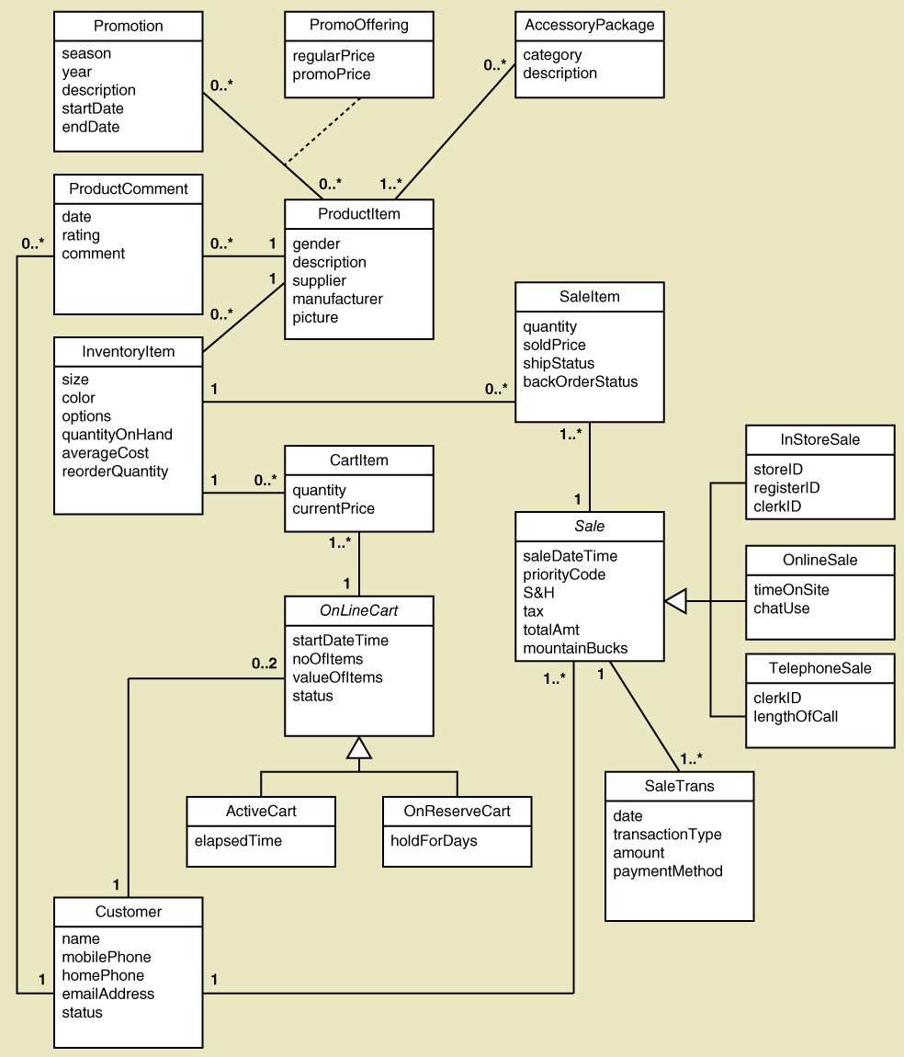
RMO CSMS Project Sales Subsystem Domain Model Class Diagrams

Slide 47
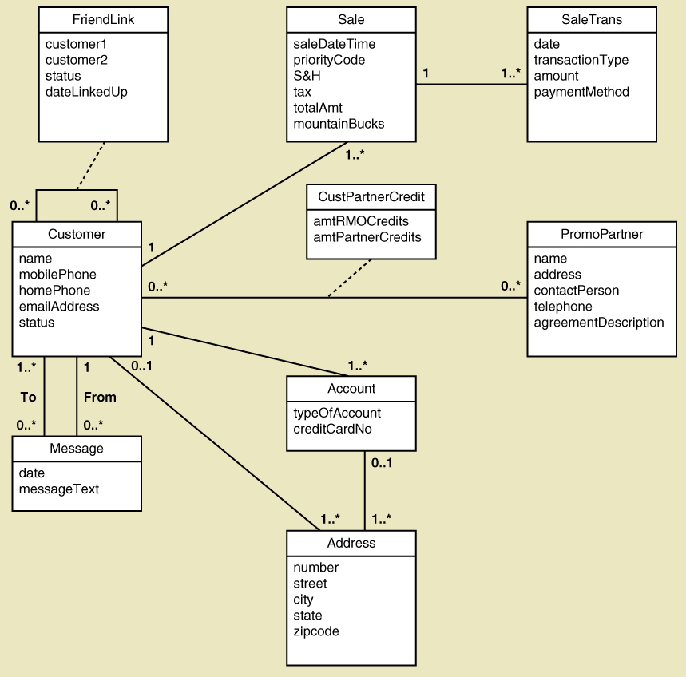
RMO CSMS Project Customer Account Subsystem Domain Model Class Diagram

Slide 48
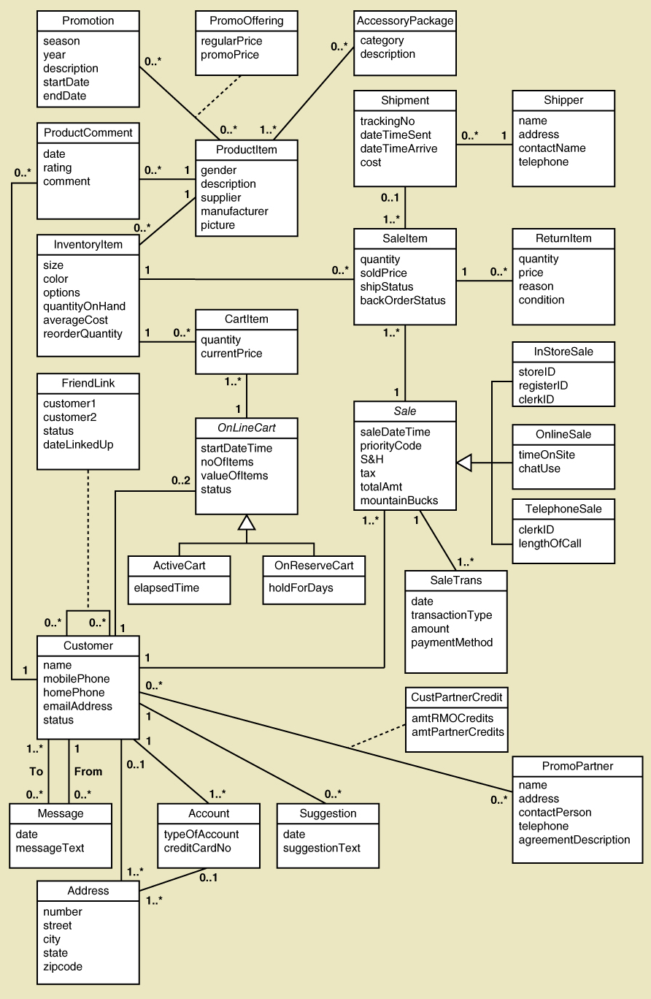
RMO CSMS Project Complete Domain Model Class Diagram

Slide 49
RMO CSMS Project Domain Model Class Diagrams
Given the complete RMO CSMS Domain Model Class Diagram and Sales and Customer Account subsystem examples:
Try completing the Order Fulfilment Subsystem Domain Model Class Diagram
Try Completing the Marketing Subsystem Domain Model Class Diagram
Try Completing the Reporting Subsystem Domain Model Class Diagram
Review the use cases from Chapter 3 and decide what classes and associations from the complete model are required for each subsystem
Classes and associations might be duplicated in more than one subsystem model

Slide 50
Object Behavior – State Machine Diagram
Each class has objects that may have status conditions or “states”
Object behavior consists of the various states and the movement between these states
State – a condition during an object’s life when it satisfies some criterion, performs an action, or waits for an event
Transition – the movement of an object from one state to another

Slide 51
State Machine Diagram
State Machine Diagram – a diagram which shows the life of an object in states and transitions
Origin state – the original state of an object before it begins a transition
Destination state – the state to which an object moves after completing a transition
pseudostate – the starting point in a state machine diagram. Noted by a black circle.
action-expression – some activity that must be completed as part of a transition
guard-condition – a true/false test to see whether a transition can fire

Slide 52
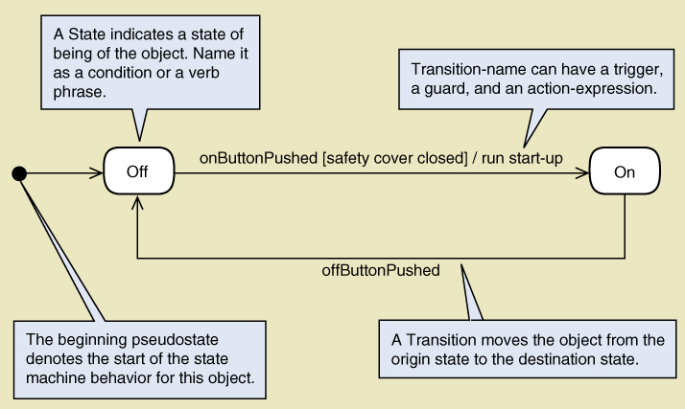
State Machine for a Printer
Syntax of transition statement
transition-name (parameters, …) [guard-condition] / action-expression

Slide 53
Concurrency in a State Machine Diagram
Concurrent states – when an object is in one or more states at the same time
Path – a sequential set of connected states and transitions
Concurrent paths – when multiple paths are being followed concurrently, i.e. when one or more states in one path are parallel to states in another path

Slide 54
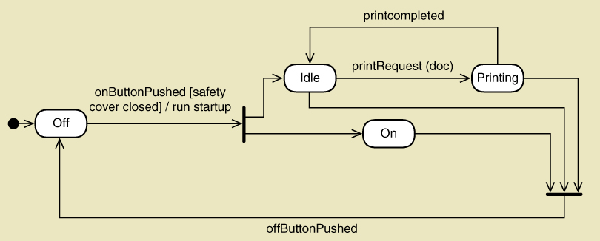
Printer with Concurrent Paths
Concurrent paths often shown by synchronization bars (same as Activity Diagram)
Multiple exits from a state is an “OR” condition.
Multiple exits from a synchronization bar is an “AND” condition.

Slide 55
Creating a State Machine Diagram Steps
Review the class diagram and select classes that might require state machine diagrams
For each class, make a list of status conditions (states) you can identify
Begin building diagram fragments by identifying transitions that cause an object to leave the identified state
Sequence these states in the correct order and aggregate combinations into larger fragments
Review paths and look for independent, concurrent paths

Slide 56
Creating a State Machine Diagram Steps (continued)
Look for additional transitions and test both directions
Expand each transition with appropriate message event, guard condition, and action expression
Review and test the state machine diagram for the class
Make sure state are really state for the object in the class
Follow the life cycle of an object coming into existence and being deleted
Be sure the diagram covers all exception condition
Look again for concurrent paths and composite states

Slide 57
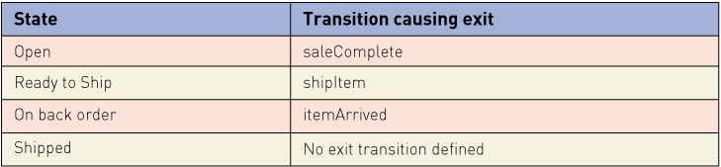
RMO – Creating a State Machine Diagram Steps -- SaleItem
Choose SaleItem. It has status conditions that need to be tracked
List the states and exit transitions

Slide 58
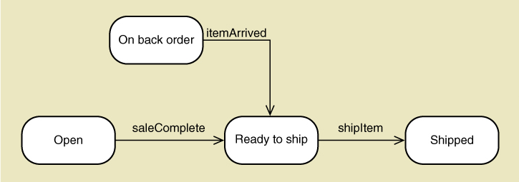
RMO – Creating a State Machine Diagram Steps -- SaleItem
Build fragments – see figure below
Sequence in correct order – see figure below
Look for concurrent paths – none

Slide 59
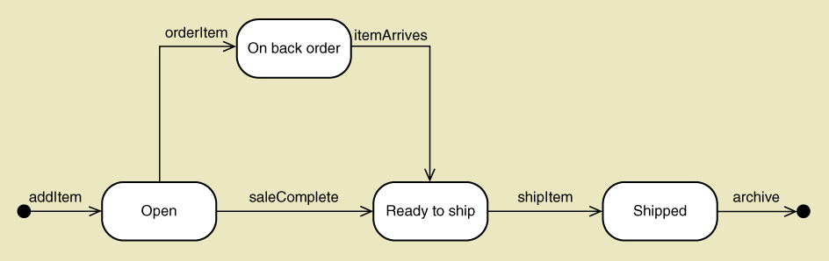
RMO – Creating a State Machine Diagram Steps -- SaleItem
Add other required transitions
Expand with guard, action-expressions etc.
Review and test
Below is the final State Machine Diagram

Slide 60
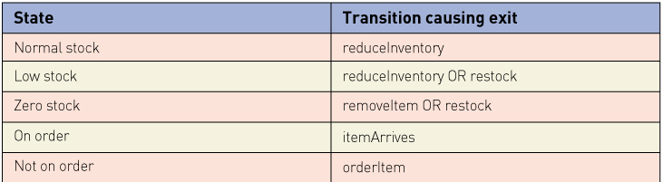
RMO – Creating a State Machine Diagram Steps -- InventoryItem
Choose InventoryItem. It has status conditions that need to be tracked
List the states and exit transitions

Slide 61
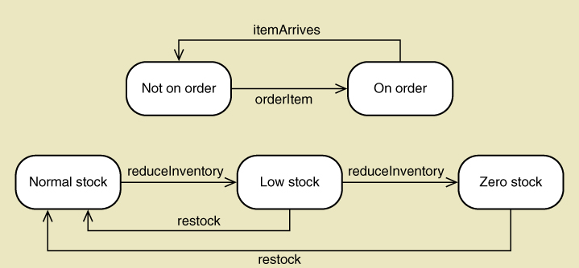
RMO – Creating a State Machine Diagram Steps -- InventoryItem
Build fragments – see figure below
Sequence in correct order – see figure below
Look for concurrent paths – see figure below

Slide 62
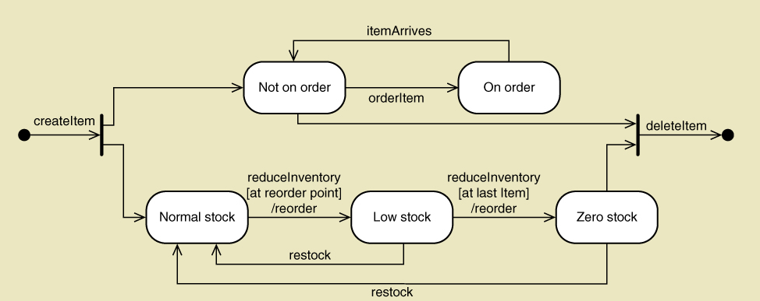
RMO – Creating a State Machine Diagram Steps -- InventoryItem
Add other required transitions
Expand with guard, action-expressions etc.
Review and test
Below is the final State Machine Diagram

Slide 63
Summary
This chapter focuses on modeling functional requirements as a part of systems analysis
“Things” in the problem domain are identified and modeled, called domain classes or data entities
Two techniques for identifying domain classes/data entities are the brainstorming technique and the noun technique
Domain classes have attributes and associations
Associations are naturally occurring relationships among classes, and associations have minimum and maximum multiplicity

Slide 64
Summary
Entity-relationship diagrams (ERDs) show the information about data entities
ERDs are often preferred by database analysts and are widely used
ERDs are not UML diagrams, and an association is called a relationship, multiplicity is called cardinality, and generalization/specialization (inheritance) and whole part relationships are usually not shown

Slide 65
Summary
The UML class diagram notation is used to create a domain model class diagram for a system. The domain model classes do not have methods because they are not yet software classes.
There are actually three UML class diagram relationships: association relationships, generalization/specialization (inheritance) relationships, and whole part relationships
Other class diagram concepts are abstract versus concrete classes, compound attributes, composition and aggregation, association classes, super classes and subclasses

Slide 66
Summary
Some objects have a life cycle with status conditions that change and should be tracked
A State Machine Diagram tracks the behavior of these objects with states and transitions
To develop a State Machine Diagram
Choose a single object class.
Identify the states and exit transitions
Identify concurrent paths
Identify additional paths
Build the State Machine Diagram

